Slide 1
Engineering Economy
Chapter 2: Cost Concepts and Design Economics

Slide 2
The objective of Chapter 2 is to analyze short-term alternatives when the time value of money is not a factor.

Slide 3
Costs can be categorized in several different ways.
Fixed cost: unaffected by changes in activity level
Variable cost: vary in total with the quantity of output (or similar measure of activity)
Incremental cost: additional cost resulting from increasing output of a system by one (or more) units

Slide 4
More ways to categorize costs
Direct: can be measured and allocated to a specific work activity
Indirect: difficult to attribute or allocate to a specific output or work activity (also overhead or burden)
Standard cost: cost per unit of output, established in advance of production or service delivery

Slide 5
Some useful cost terminology
Cash cost: a cost that involves a payment of cash.
Book cost: a cost that does not involve a cash transaction but is reflected in the accounting system.
Sunk cost: a cost that has occurred in the past and has no relevance to estimates of future costs and revenues related to an alternative course of action.

Slide 6
More useful cost terminology
Opportunity cost: the monetary advantage foregone due to limited resources. The cost of the best rejected opportunity.
Life-cycle cost: the summation of all costs related to a product, structure, system, or service during its life span.

Slide 7
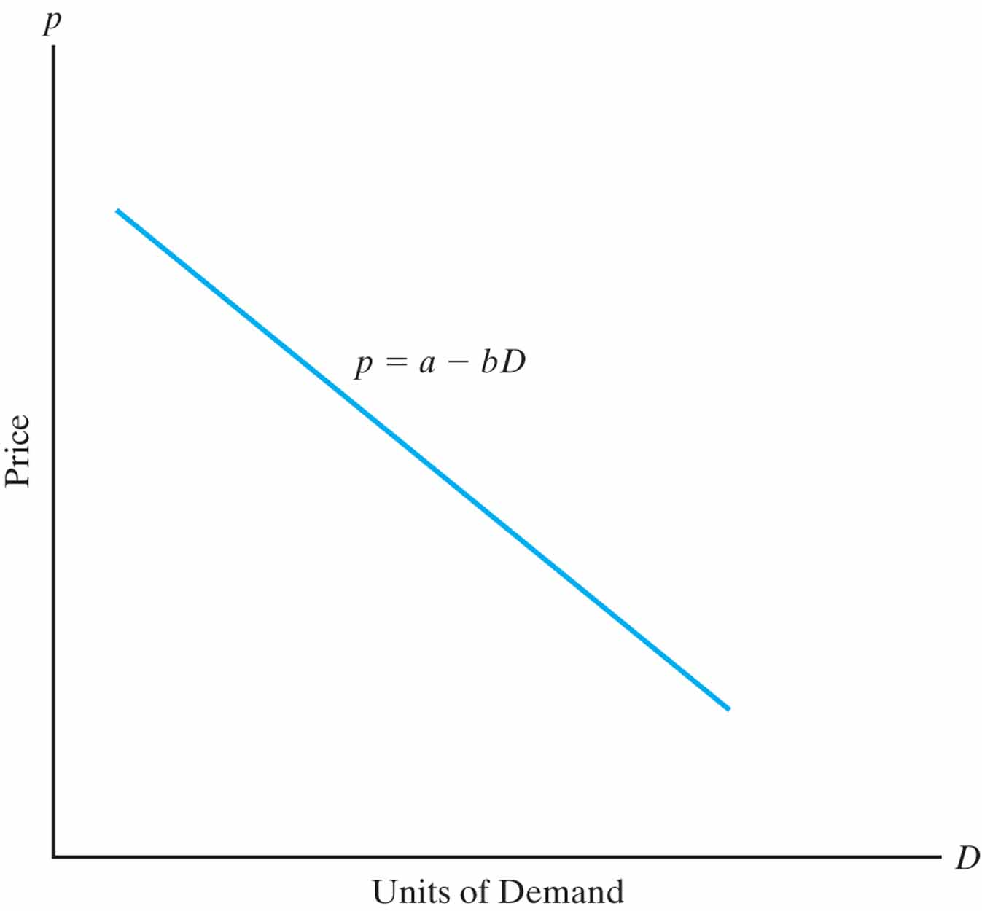
The general price-demand relationship
The demand for a product or service is directly related to its price according to p=a-bD where p is price, D is demand, and a and b are constants that depend on the particular product or service.

Slide 8
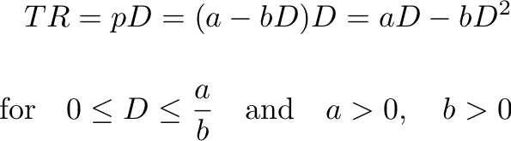
Total revenue depends on price and demand.
Total revenue is the product of the selling price per unit, p, and the number of units sold, D.

Slide 9
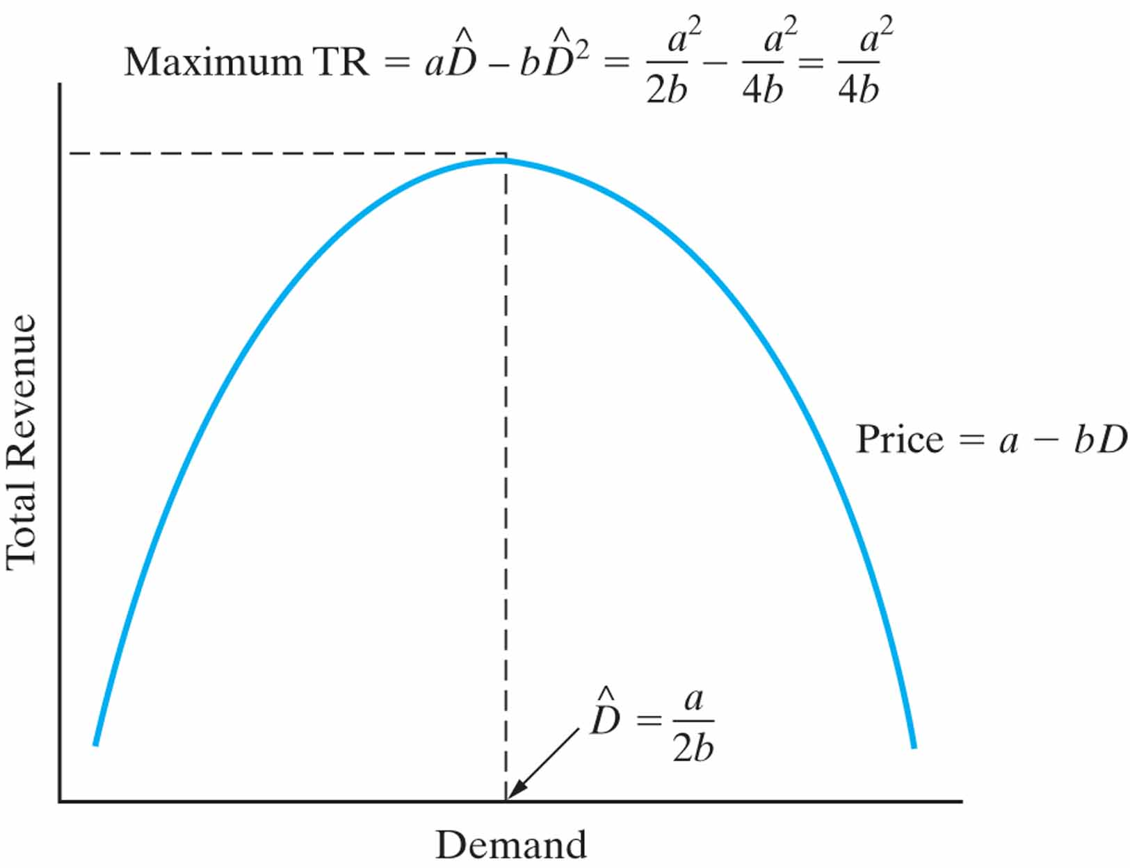


Calculus can help determine the demand that maximizes revenue.
Solving, the optimal demand is

Slide 10


We can also find maximum profit…
Profit is revenue minus cost, so
for
Differentiating, we can find the value of D that maximizes profit.

Slide 11

And we can find revenue/cost breakeven.
Breakeven is found when total revenue = total cost. Solving, we find the demand at which this occurs.

Slide 12
Engineers must consider cost in the design of products, processes and services.
“Cost-driven design optimization” is critical in today’s competitive business environment.
In our brief examination we examine discrete and continuous problems that consider a single primary cost driver.

Slide 13
Two main tasks are involved in cost-driven design optimization.
Determine the optimal value for a certain alternative’s design variable.
Select the best alternative, each with its own unique value for the design variable.
Cost models are developed around the design variable, X.

Slide 14
Optimizing a design with respect to cost is a four-step process.
Identify the design variable that is the primary cost driver.
Express the cost model in terms of the design variable.
For continuous cost functions, differentiate to find the optimal value. For discrete functions, calculate cost over a range of values of the design variable.
Solve the equation in step 3 for a continuous function. For discrete, the optimum value has the minimum cost value found in step 3.

Slide 15

Here is a simplified cost function.
where,
a is a parameter that represents the directly varying cost(s),
b is a parameter that represents the indirectly varying cost(s),
k is a parameter that represents the fixed cost(s), and
X represents the design variable in question.

Slide 16
“Present economy studies” can ignore the time value of money.
Alternatives are being compared over one year or less.
When revenues and other economic benefits vary among alternatives, choose the alternative that maximizes overall profitability of defect-free output.
When revenues and other economic benefits are not present or are constant among alternatives, choose the alternative that minimizes total cost per defect-free unit.

